Slide 1
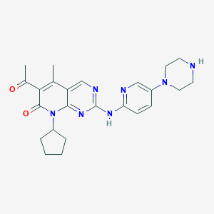
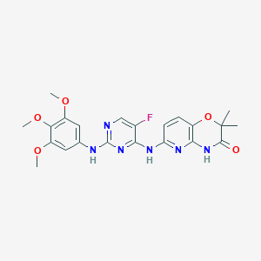
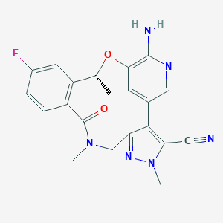
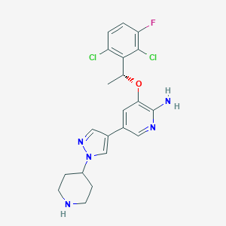
Criteria of ligand Selection
Scaffold (hetero aromatic ring) 골격을 1개 이상 포함 시킨다.
Ring의 개수는 3~6개 (평균 4개)
Rule of five- MW: 300-650 (평균:510), HD:1-4개 (평균:2개), HA:4-11개 (평균: 8개), Rotatable bonds: 0-11 (평균: 6개)
Ring-linker-Ring: 주로 ring과 ring 사이는 direct, -O-, -NH-, -CH2-, -S-, -CONH- 등의 bond로 연결됨. (aromatic ring과 aliphatic ring사이는 긴 linker가 사용되기도 함. 이런 경우 kinase의 hydrophobic region이 아닌 입구 쪽인 solvent region(open된 공간)에 위치하여 linker가 길어도 됨)
Aromatic ring은 주로 6-,5-membered ring, aliphatic ring은 주로 3-6 membered ring, macrocycle ring도 종종 drug으로 나옴
Aliphatic ring은 주로 terminal 또는 side chain에 위치한다.
치환기로 halogen (빈도수 F> Cl> Br> I) group은 필수는 아니지만 종종 포함 시킨다. (halogen bonding에 참여)
Chiral center < 3
Ex)
Macrocycle:12-membered ring
Halogen group (치환기)
R group (치환기)
linker
terminal
Side chain
Scaffold
Palbociclib_2euf/5l2i
R406_3fqs
Lorlatinib_5A9U
Crizotinib_3zbf/2xp2/2wgj

Slide 2
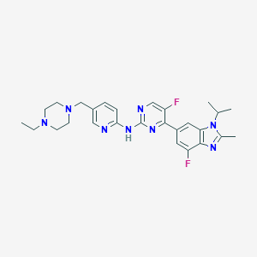
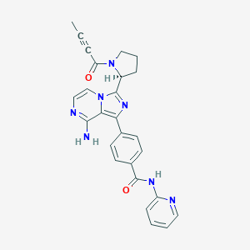
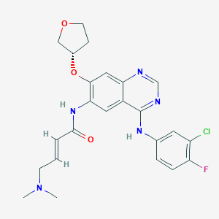
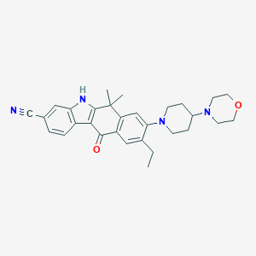
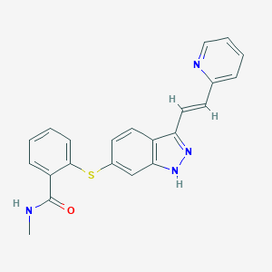
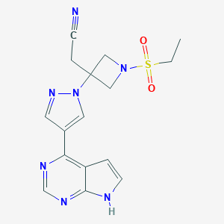
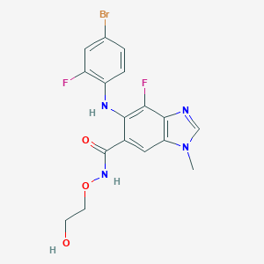
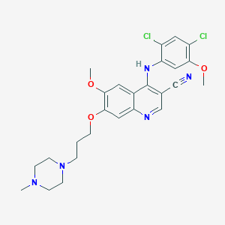
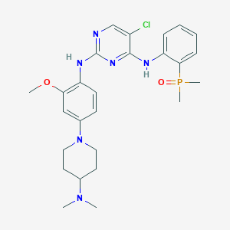
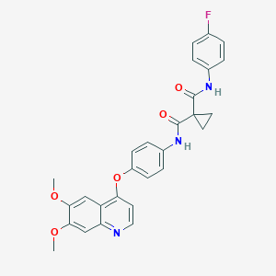
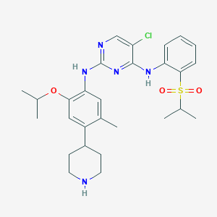
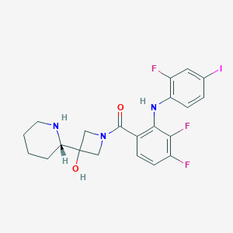
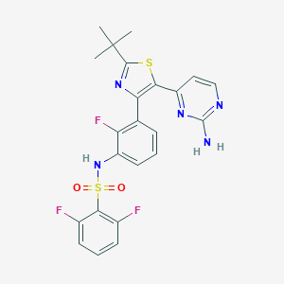
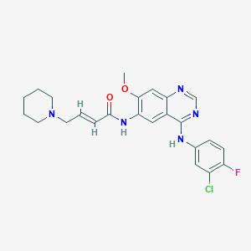
2D Structures of FDA-approved Protein Kinase Inhibitors
Abemaciclib_5l2s
Acalabrutinib
Afatinib (covalent)_4g5j
Alectinib_3aox
Axitinib_4ag8
Baricitinib_4w9x
Binimetinib
Bosutinib_4mxo/3ue4
Brigatinib_6mx8
Cabozantinib
Ceritinib_4mkc
Cobimetinib_4an2 (allosteric)
Crizotinib_3zbf/2xp2/2wgj
Dabrafenib_5csw
Dacomitinib (covalent)_ 4I23

Slide 3
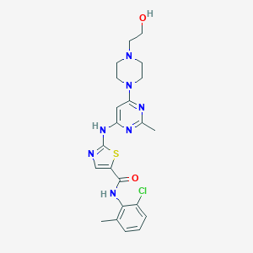
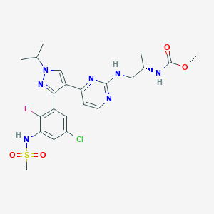
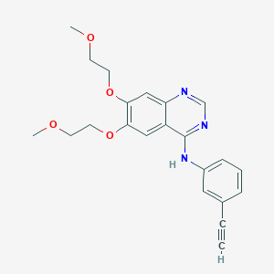
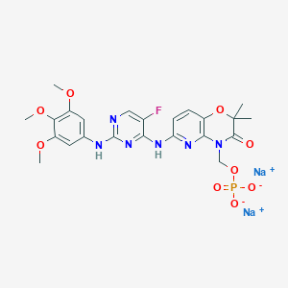
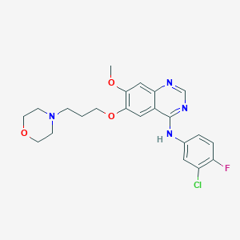
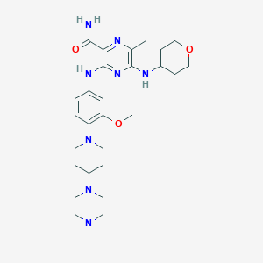
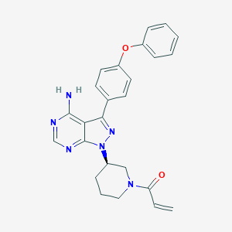
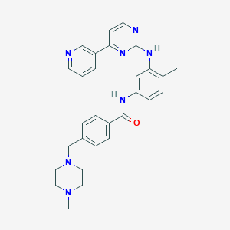
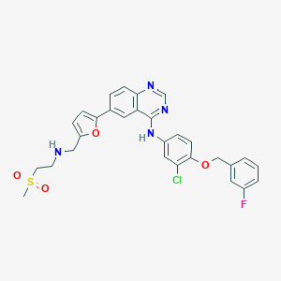
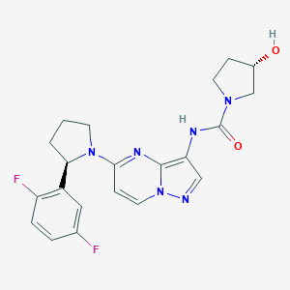
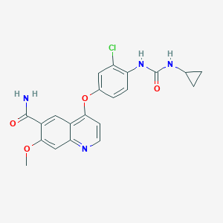
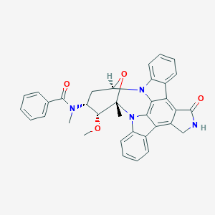
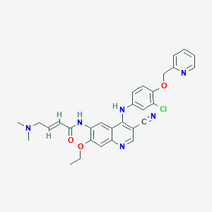
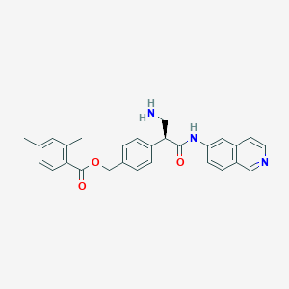
2D Structures of FDA-approved Protein Kinase Inhibitors
Dasatinib_2gqg
Encorafenib
Erlotinib_1m17/4hjo
Fostamatinib
Gefitinib_2ity
Gilteritinib_6JQR
Ibrutinib (covalent)_5p9j
Imatinib_1xbb/1iep/1t46
Lapatinib_1xkk
Larotrectinib
Lenvatinib_3wzd
Lorlatinib_5A9U
Midostaurin
Neratinib (covalent)_2jiv
Netarsudil

Slide 4
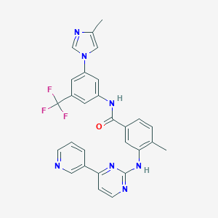
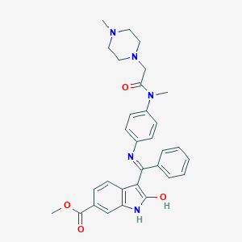
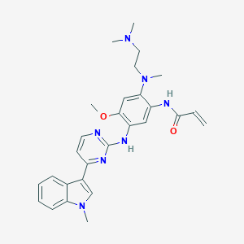
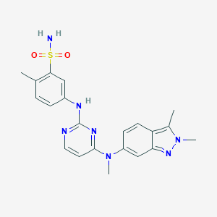
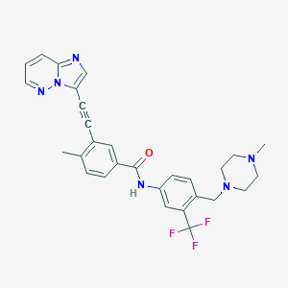
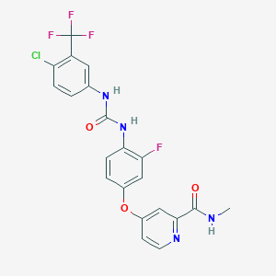
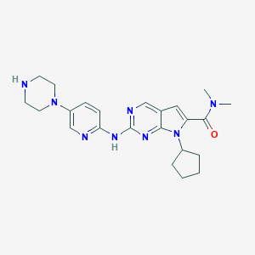
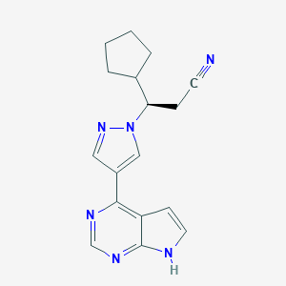
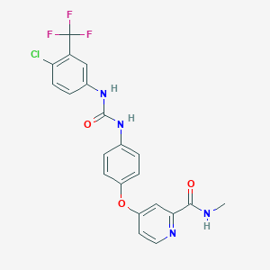
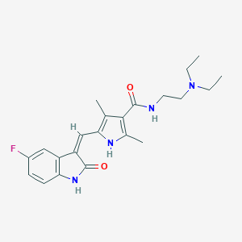
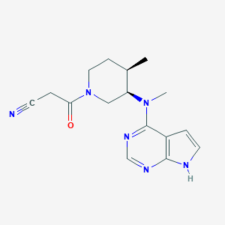
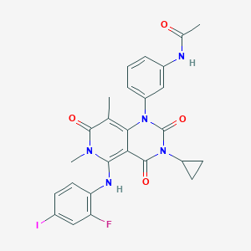
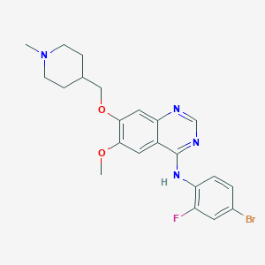
2D Structures of FDA-approved Protein Kinase Inhibitors
Nilotinib_3cs9_ similar imatinib
Nintedanib_6NEC
Osimertinib (covalent)_4ZAU
Palbociclib_2euf/5l2i
Pazopanib
Ponatinib_3oxz/4u0i
similar imatinib
R406_3fqs
Regorafenib
Ribociclib_5l2t
Ruxolitinib_4U5J
Sorafenib_3rgf/4asd
Sunitinib_3g0e/4agd
Tofacitinib_3eyg/3lxk
Trametinib
Vandetanib_2ivu

Slide 5
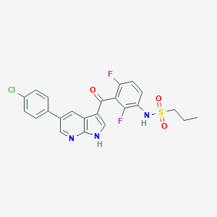
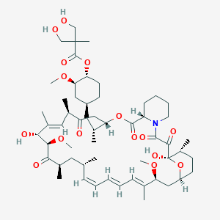
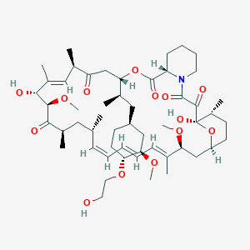
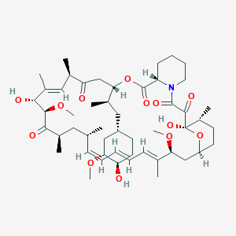
2D Structures of FDA-approved Protein Kinase Inhibitors
Vemurafenib_3og7
Temsirolimus
Everolimus
Sirolimus
Mainly five or six membered ring
Mostly up to two fused-ring
Almost heterocycle, aromatic ring (hinge region, back pocket)
Occasionally aliphatic ring (solvent region)

